Slide 1
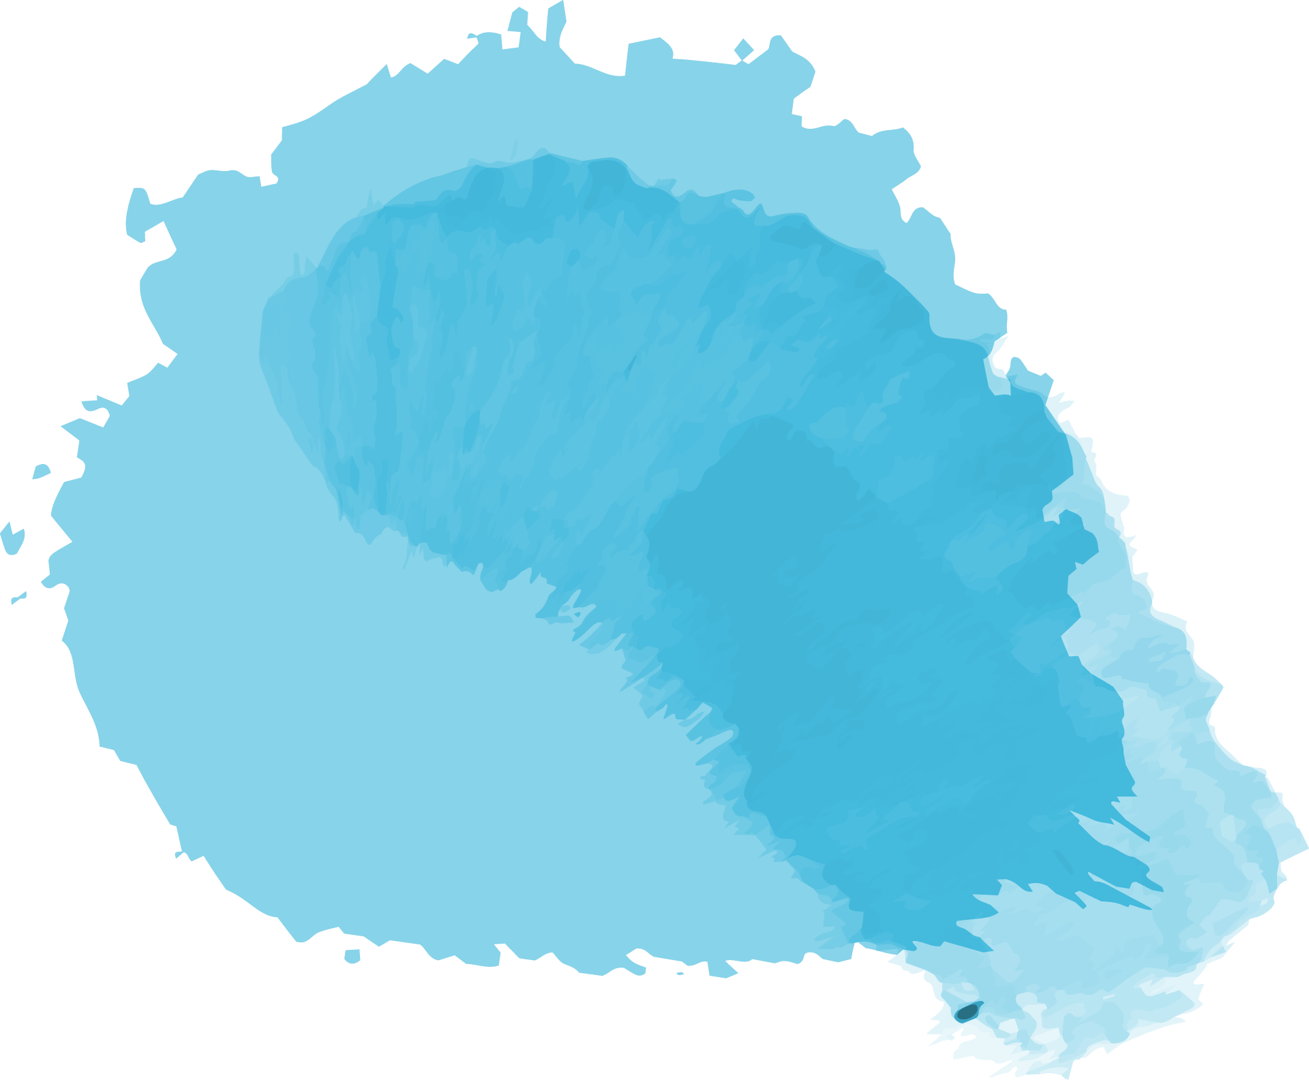
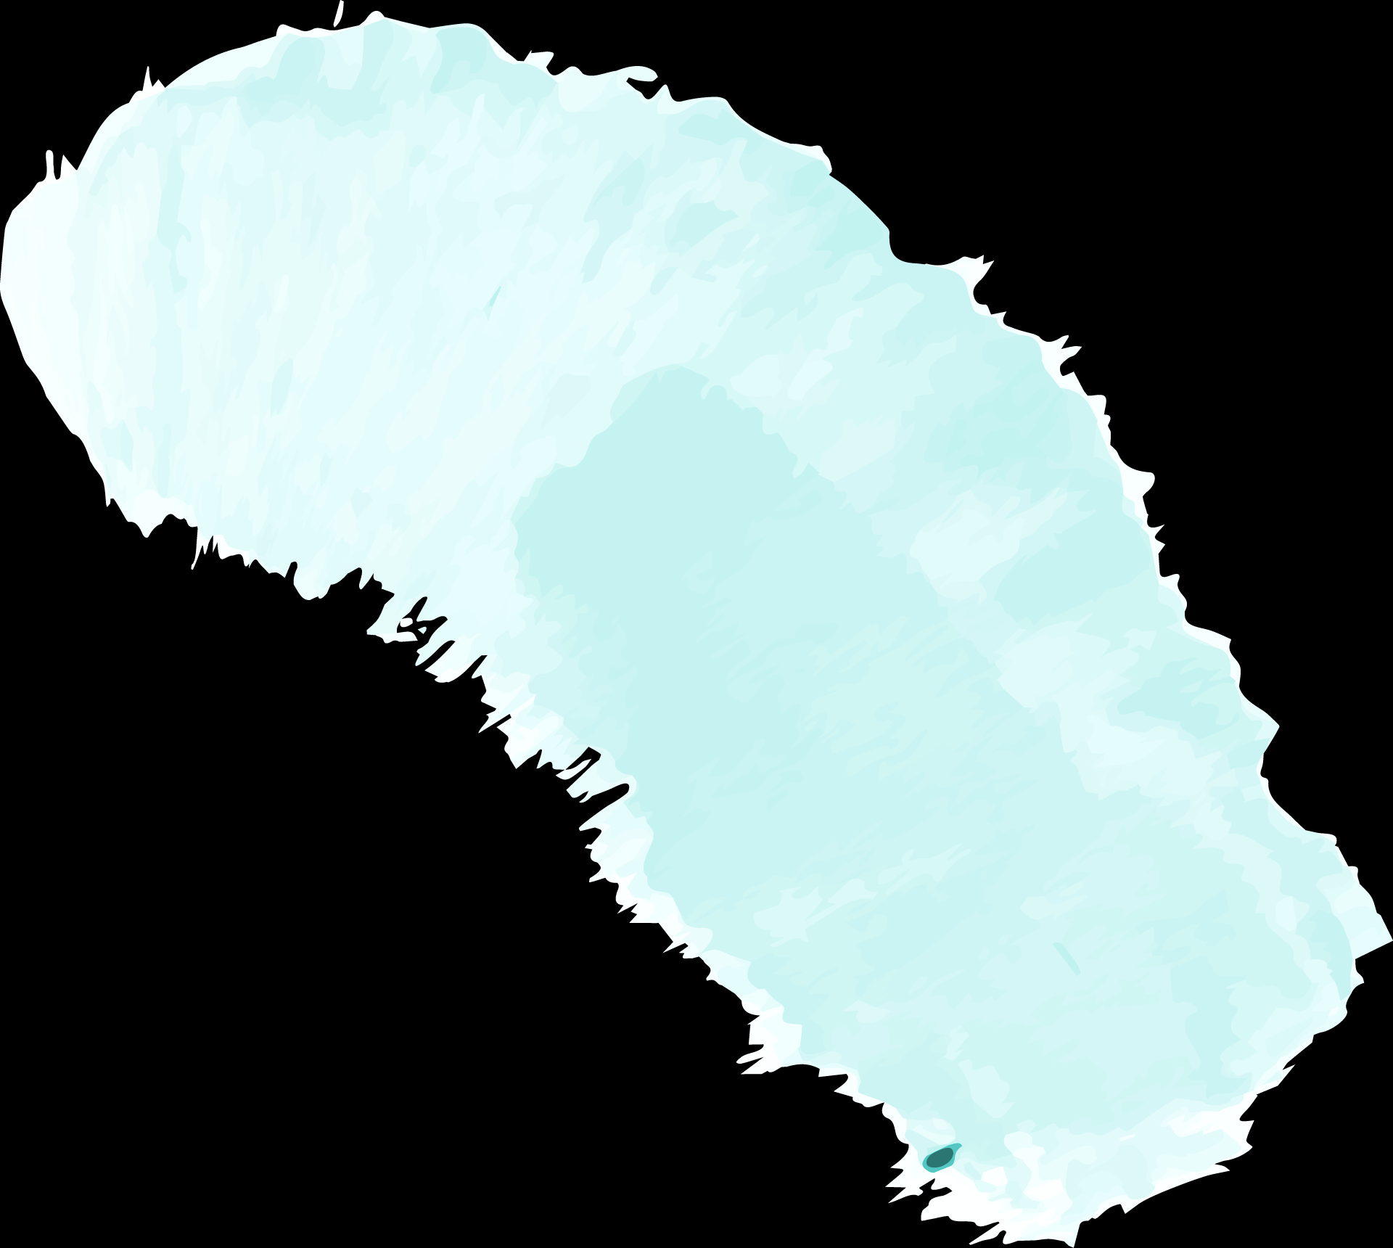
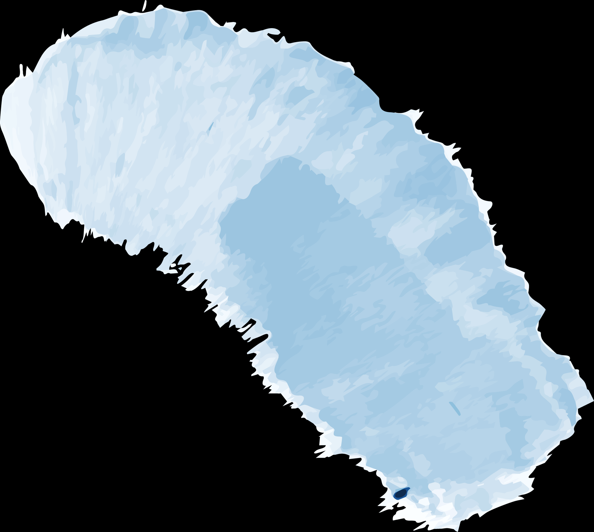
COVID-19
Medical Image Analysis
12/07/2020
Chengyuan Cai, Tiancheng Ren, Yuchen Sun, Yanwen Wang

Slide 2


Motivation
01
02
03
04
Help identify suspected Covid-19 cases
Improve efficiency of diagnosis of patients
Reduce the occurence of misdiagnosis
Develop useful new algorithm

Slide 3
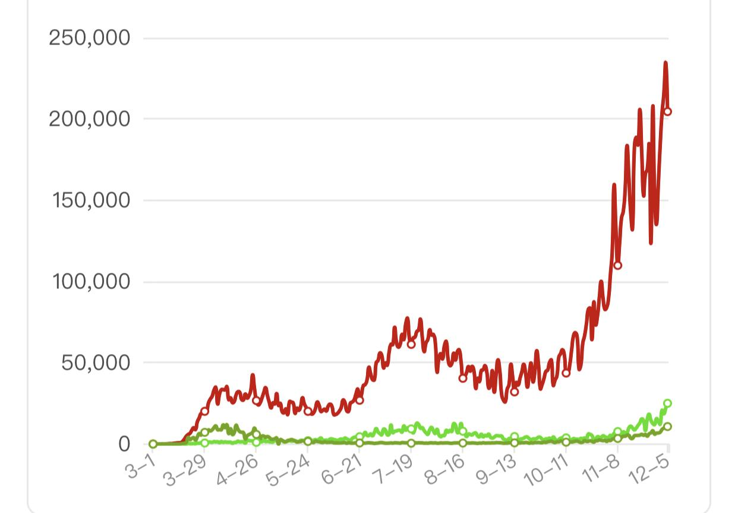
Background
DAILY NEW CASES IN UNITED STATES
Developing machine-learning based programs to aid the diagnosis of COVID-19 and other lung diseases in combination with computed tomography

Slide 4
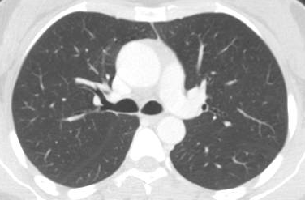
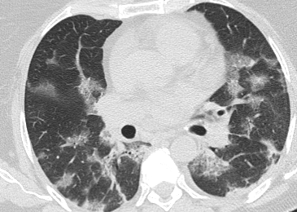
Healthy VS. Infected

Slide 5


Target Task & Proposed Solution
Common Model
New Algorithm
Target
Task
Identify possible COVID-19 infections by using machine learning approach
Apply five common models
Develop a brand new algorithm which based on weight function
Analyze model results and compare each of them by accuracies and speed

Slide 6
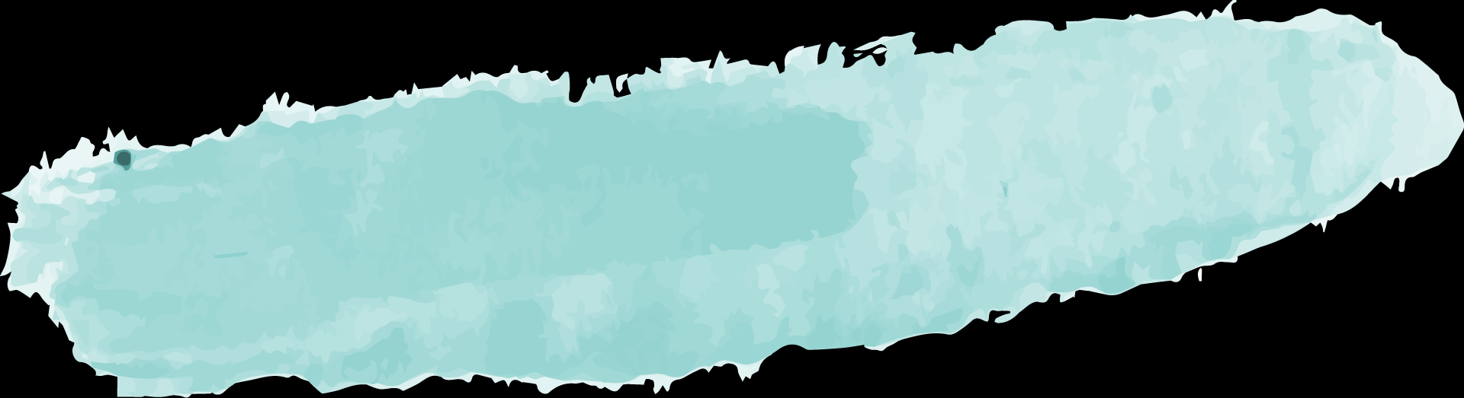
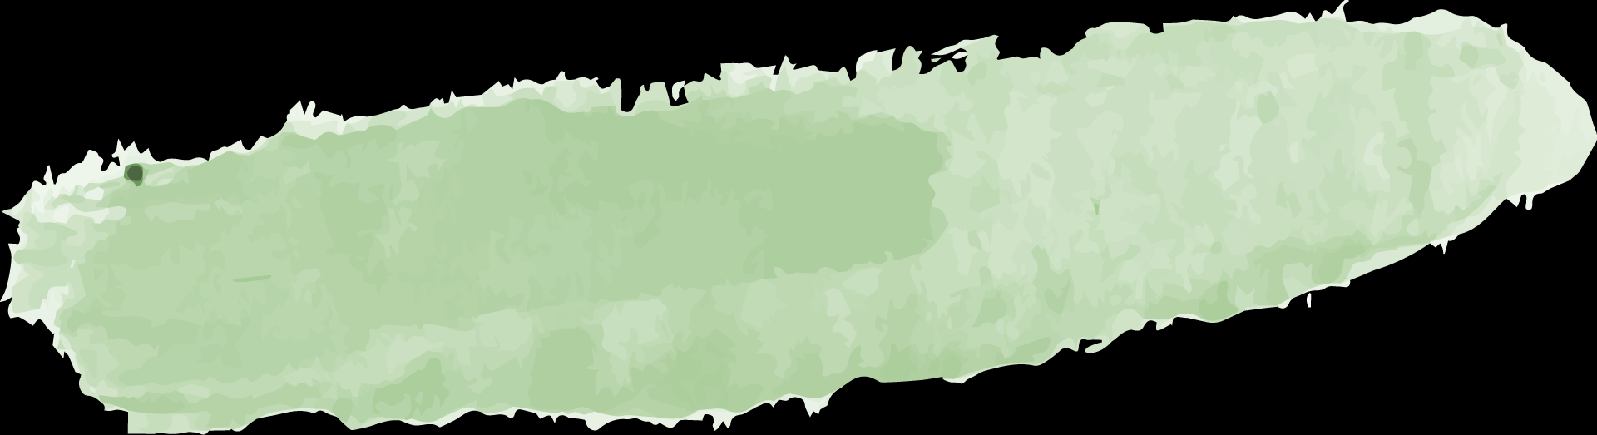
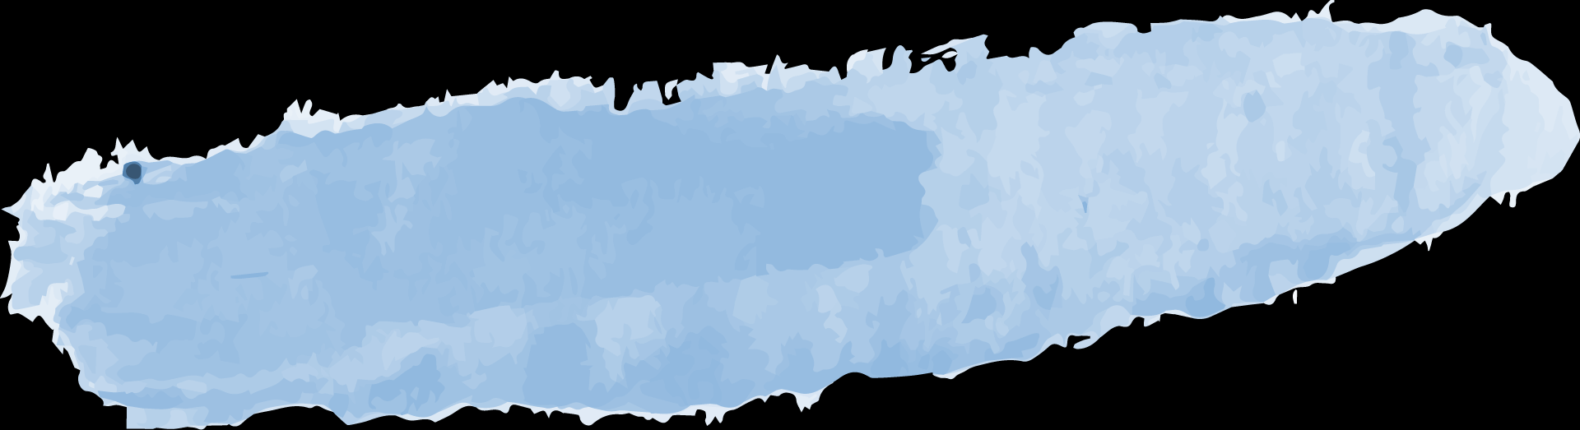
Common Model Summary
MLP
CNN
ResNet
Multi-Layer Perceptron
Convolutional Neural Network
Residual Network
KNN
SVM
K-Nearest Neighbors
Support Vector Machine

Slide 7
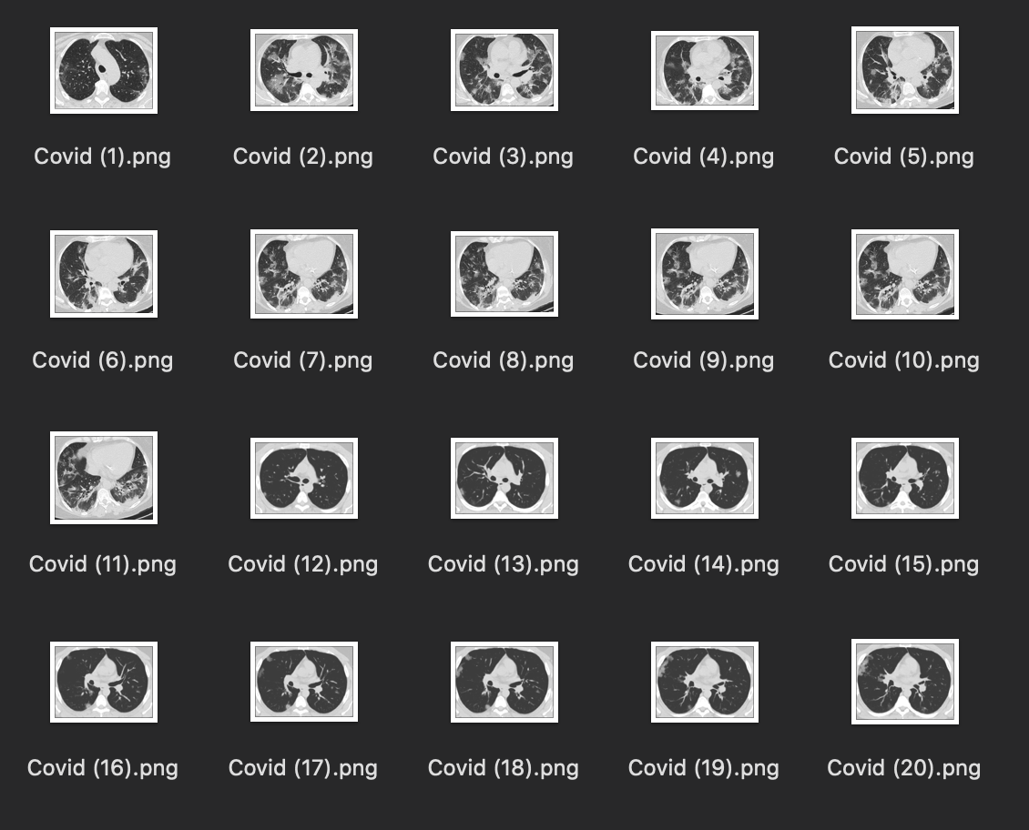
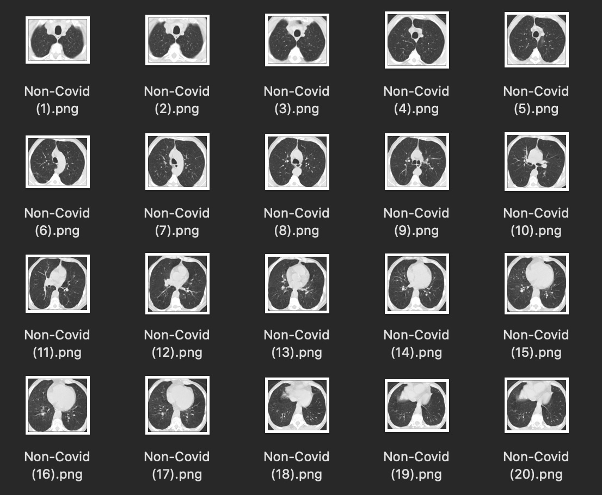
Dataset
1252 COVID infected lung scans
1230 healthy lung scans

Slide 8
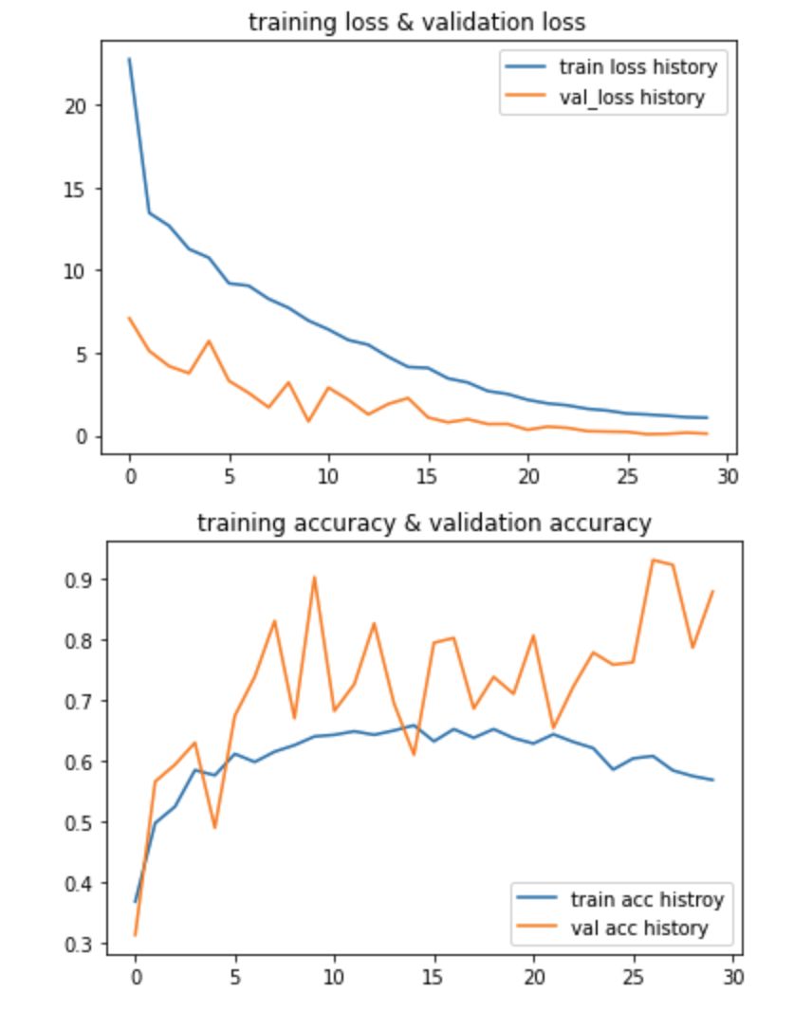
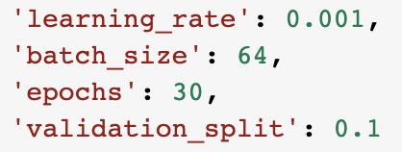
Implementation-MLP
Relative High Validation Accuracy: around 80%
Medium Training Accuracy: around 60%

Slide 9
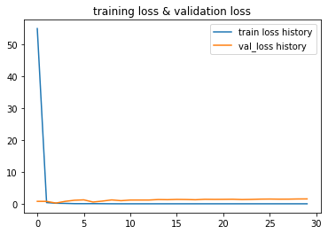
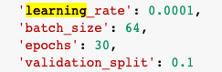
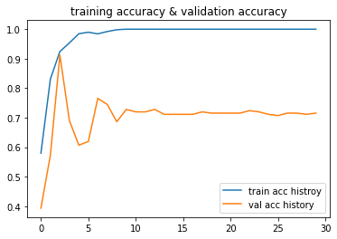
Implementation-CNN
Optimizer: Adam
Highest training Accuracy: 100%
Relatively High validation accuracy: 70%
Relatively High test accuracy: around 80%

Slide 10
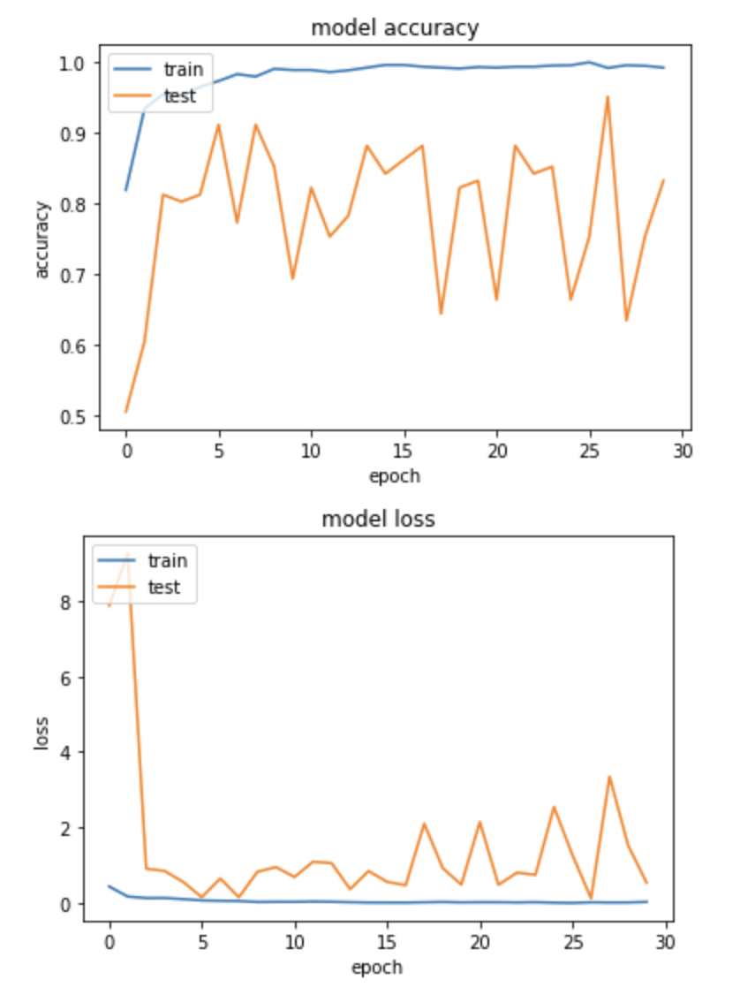
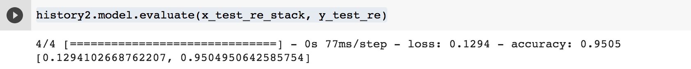
Implementation-ResNet
01
Use transfer learning to create ResNet50, ResNet101, and ResNet152 models and fine tune each model.
Compare the validation accuracy of each model: ResNet152 is less stable and ResNet50 has relatively lower accuracy compared with the other two.
02

Slide 11
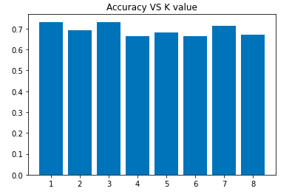
Implementation-KNN
K Value | Accuracy
1 | 0.73
2 | 0.69
3 | 0.73
4 | 0.66
5 | 0.68
6 | 0.66
7 | 0.71
8 | 0.67

Slide 12
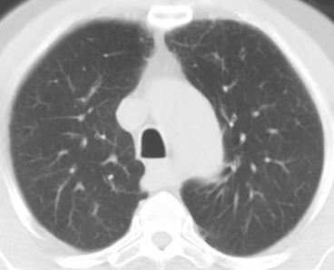
Implementation-SVM
01
Read in CT image files as numpy arrays
Create SVM matrix for training
02
pixel1 | pixel2 | … | pixel40000 | label
198 | 184 | … | 254 | 1
68 | 68 | … | 228 | 0
COVID
Non-COVID

Slide 13
Implementation-Our Model
Read in CT image files as numpy arrays
Generate the weight of all images, determine the potential lung cavity region
Train the model
Random select pixels, expand to 50x50 block
determine if the block represents lung cavity
determine parameters
Use the model to predict test samples
Calculate scores for COVID and NON-COVID cases
Compare the score to determine the result

Slide 14
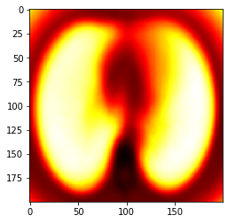
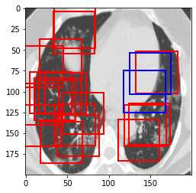
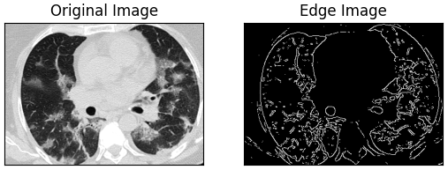
Implementation - Our Model
pixel1 | pixel2 | … | pixel40000 | label
198 | 184 | … | 254 | 1
68 | 68 | … | 228 | 0
COVID
Non-COVID
COVID Score: xxx
Non-COVID Score: xxx
[ 184.92345317 122.13717546 174.48917112 49.18585586 7579.13316852]
[ 140.36916401 113.84491405 176.84756763 47.74327912 7305.1220815 ]

Slide 15
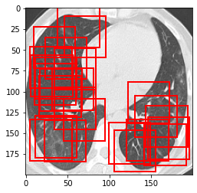
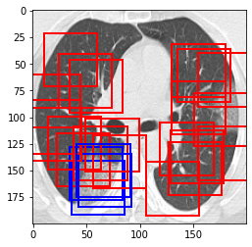
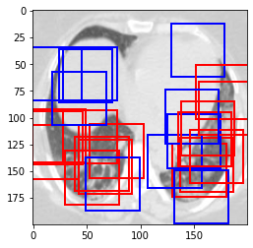
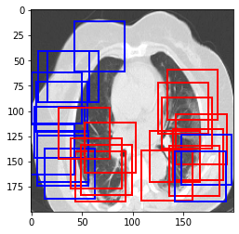
Implementation - Our Model

Slide 16
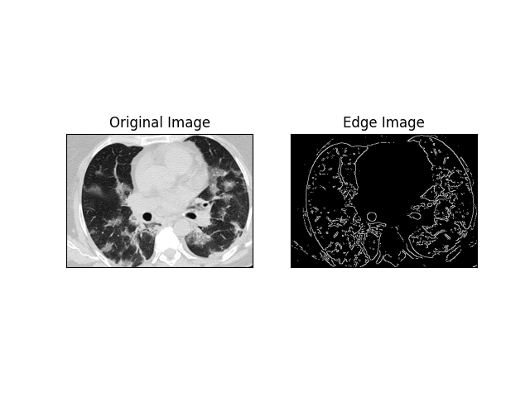
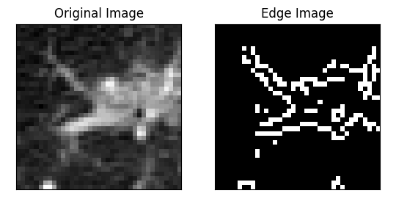
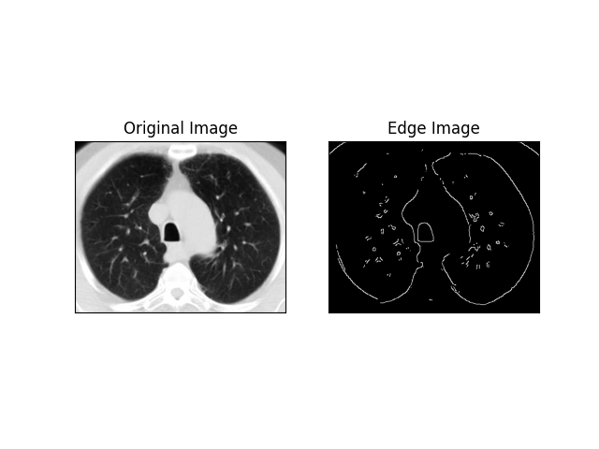
Implementation - Our Model

Slide 17
Contributions
Find one model with the highest accuracy
Provide doctors with auxiliary judgment on patients’ conditions
Provide a stable and rapid way for detecting covid ct-scans

Slide 18
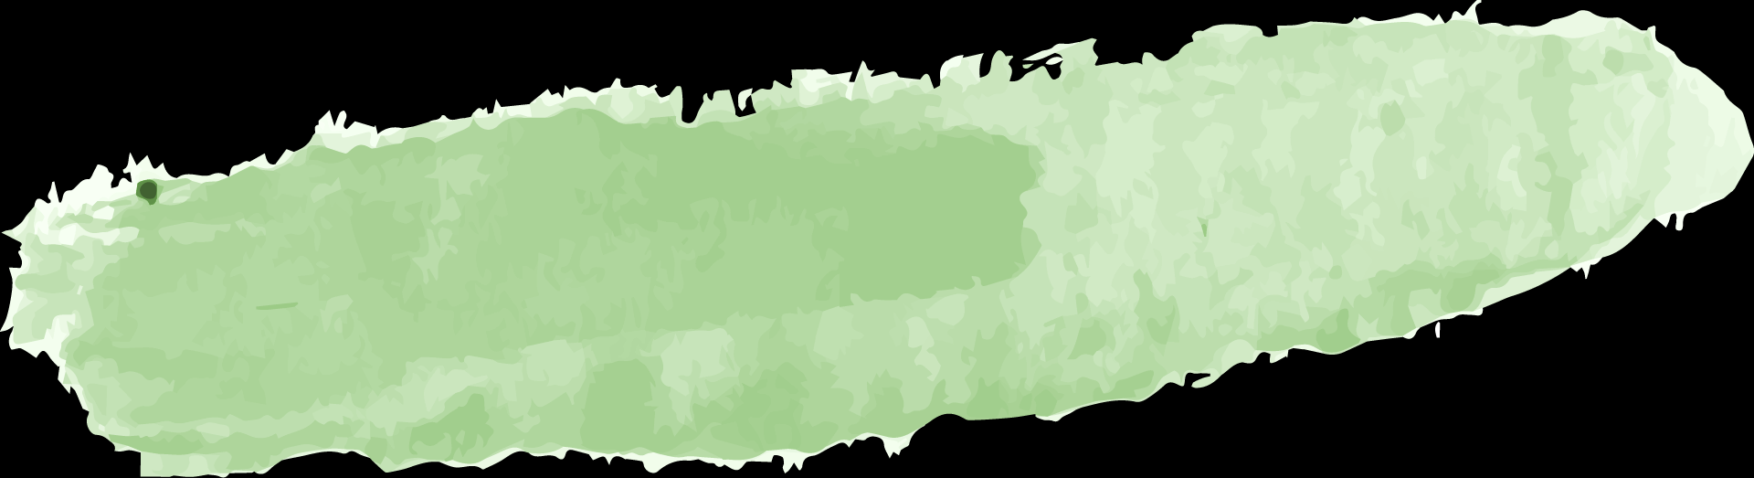
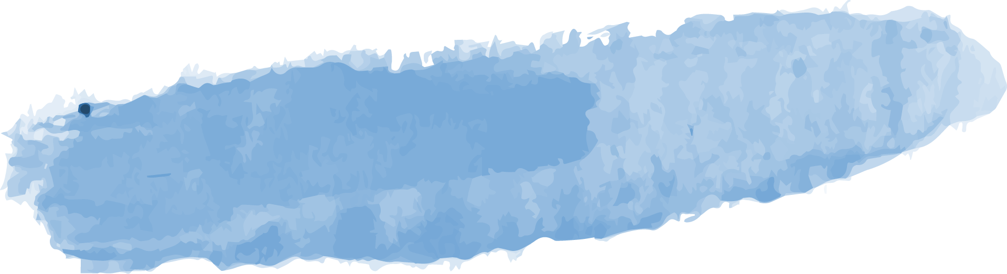
Data Summary
 | Best Test Accuracy | Average Time (min)*
MLP | 0.7 ~ 0.8 | 10
CNN | 0.78 | 5
ResNet101 | 0.95 | 25
KNN | 0.73 | 10
SVM | 0.88 | 20
Our Model | 0.85 | 1
* Without the time of loading data

Slide 19
Experimental Result and Conclusion
MLP, CNN, ResNet101
KNN, SVM
Higher average accuracy
Blackbox
ResNet101 has highest accuracy
Unstable (acc 64~96)
Time consuming (~25 min)
Lower average accuracy
Transparent
Considers all pixels in an image

Slide 20
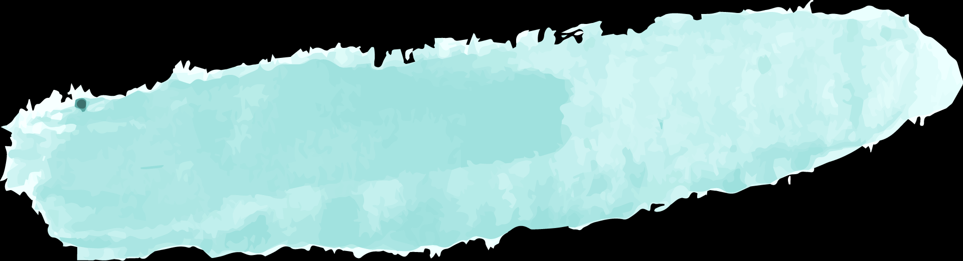
KNN, SVM
High Accuracy
Our Model
MLP, CNN, ResNet101
High speed
Initially considers all pixels
Faster speed
Evaluate lung cavity only
Consider key regions with higher weight
Calculate transparent scores

Slide 21
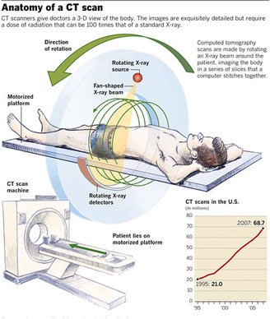
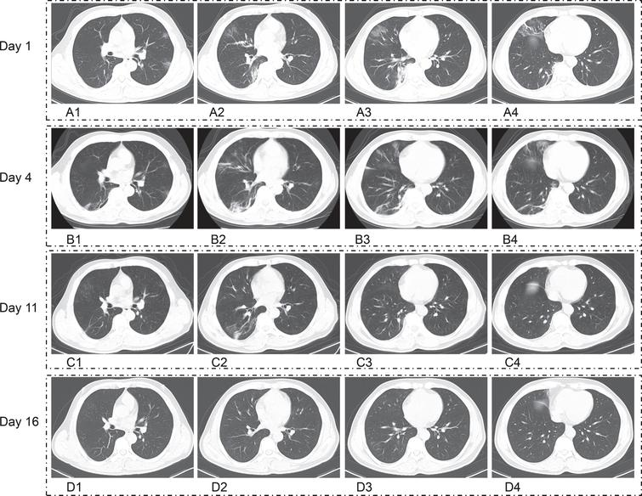
Experimental Analysis
155cm
150cm
145cm
140cm

Slide 22
Future Work
Get more training data that includes detailed information about lung cavity and try to improve the performance of our model
Find CT scans dataset that has already been segmented by radiologists and try other models such as YOLO to determine the anatomical location of the lesion

Slide 23
References
https://blog.paperspace.com/fighting-coronavirus-with-ai-building-covid-19-classifier/
https://docs.opencv.org/master/
https://opencv-python-tutroals.readthedocs.io/en/latest/py_tutorials/py_imgproc/py_canny/py_canny.html
https://arxiv.org/abs/1512.03385
https://www.medmastery.com/guide/covid-19-clinical-guide/how-identify-covid-19-chest-ct-scan

Slide 24
THANKS

